Slide 1

Transitioning to Middle School
Laurie Montgomery
School Counselor

Slide 2



Agenda
Magnet School Options
Preparation
Field Trip
Questions?

Slide 3
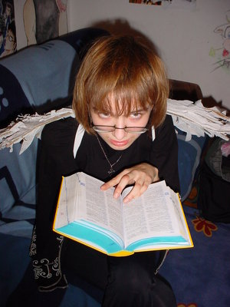



Introduction
This Photo by Unknown Author is licensed under CC BY-SA-NC
Middle School is a big change and one that is exciting and scary.
The goal of this presentation is to help you make the right choice for your child’s next step in education

Slide 4

Options for Magnet Schools
A.R. Johnson
Davidson Fine Arts
Richmond County Career Technical Magnet School

Slide 5
A. R. Johnson
Concentration in Engineering and Health
Rigorous Academic
Some sports
Video: CTW Recruitment.MP4

Slide 6
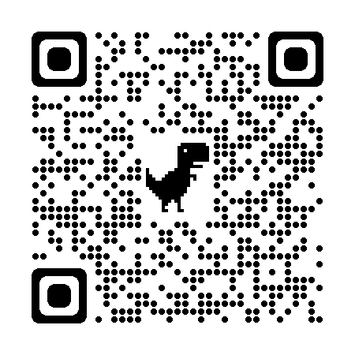
Davidson Fine Arts
Concentration in the Fine Arts
Rigorous Academics
Some sports but more drama,
music and art
Promotional Video Link

Slide 7
Davidson Fine Arts
John S. Davidson Fine Arts Magnet School Flyer.pdf

Slide 8
Richmond County Technical Magnet School
Culinary Arts
Electronics
Cyber Security
Audio Visual
Some sports

Slide 9
2021 RCTCM Recruitment Reel 1.mp4

Slide 10
Open House Dates
A.R.Johnson
Davidson Fine Arts
Richmond County Technical Career Magnet
Thursday
November 9
Time: 4:00-6:00 p.m.
Wednesday
December 6
Time: 8:30-11:30
To Be Announced

Slide 11
5th grade field trip to magnet schools
Wednesday, November 8
RCTCM-8:45-10:15
DFA-10:30-12:05
ARJ-1:15-2:30

Slide 12
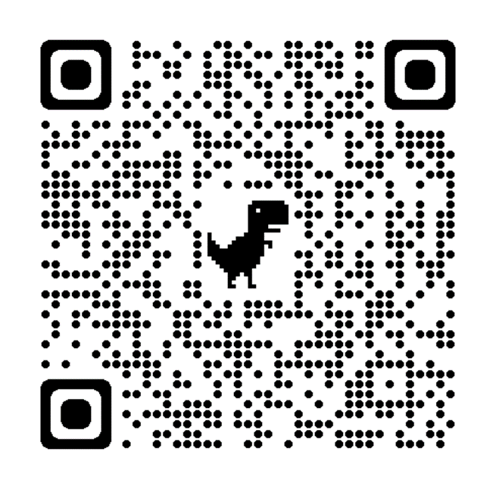
Applications
Important Dates
Application period: November 1, 2023-January 5, 2024
Testing Dates: January 24 and 27, 2024
Davidson Fine Arts Auditions: February 16, 2024
Decision letters emailed on March 1, 2024
Spring Application period: April 1-May 1, 2024
Spring Academic testing: May 11, 2024
Davidson Fine Arts Auditions: May 23 or May 24
Spring Decision letters emailed on June 3, 2024

Slide 13

Preparation
Help your child be more aware of assignments and work that needs to be completed and turned in.
Parent Portal-Use to connect to Infinite Campus to check grades
Complete an Application online beginning November 1, 2023-January 5, 2024
School Choice Guide: rcboe.org/choice

Slide 14


Thank You
Questions and Answers
Contact: montgla@boe.Richmond.k12.ga.us
Telephone: (706) 823-6950, Ext. 4859

